Slide 1



Portfolyo
Batch- 58
Create your portfolio within minutes!

Slide 2
Team - 58
Project Presentation
Team Members:
Jakkala Siva Venkata Deepesh (19H51A05G2)
Kolukula Naga Pavan Madhur (19H51A05G9)
Kokkonda Rajani (19H51A05G7)
Under the Guidance of:
Mr. M. Parameswar Sir
(Assistant professor)

Slide 3

Introduction
Website builders are one of the newly emerging tools, which are catching many people’s attention!
There are not many cost effective solutions for these kinds of tools!
Here user can create his/her own portfolio website with absolute ease using our website “Portfolyo”.
The user doesn’t need any kind of knowledge on Web Development!
What's better than that? All the services provided in our website are absolutely free. Happy Building!

Slide 4

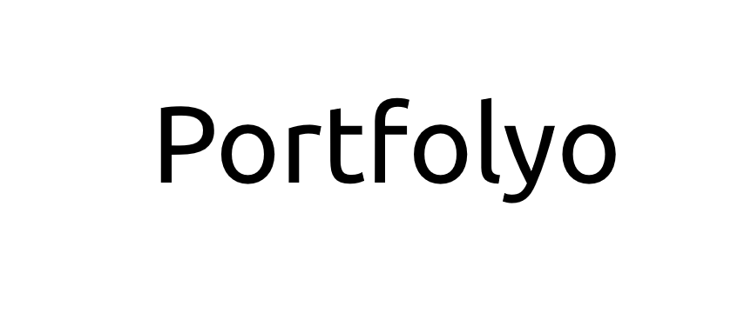
Objective:
The main objective of this project is to provide the people a way to create their personnel portfolio’s by skipping the part of learning web development from scratch.
We want to give our users many different customizations from which they can choose to match their interests and tastes.
People from various domains can create their own portfolio’s which they can show case to other’s.

Slide 5
Abstract:
Now-a-days every Tech job aimer’s are required to have a resume or a personnel website showcasing their work and skills!
Personnel websites or portfolio’s grab the interviewer attention quick as they can know about you just by clicking a link.. They need not download anything to check about you!
The major concern is that not every one knows Web Development, there are people who are really good at other technologies, since they might want their personnel portfolio’s as well, they need to learn entire Web development stack to build a basic website with complete functionality which might consume a lot of their precious time.
This is where our project “ PORTFOLYO ” comes into light, which overcomes this above stated problem!

Slide 6

1) Wordpress
Existing Models:
WordPress is a free and open-source content
management system written in PHP and paired with
a MySQL or MariaDB database. Features include a
plugin architecture and a template system, referred
to within WordPress as Themes. Wordpress offers
Various templates for the user to build their websites on!
Reference: https://en.wikipedia.org/wiki/WordPress

Slide 7

2) WIX:
Wix is a website offering users to create a
website without any knowledge of technical
stuff which is required to build a website. They too offer their customers with various customizations to build their own websites.
Reference: https://en.wikipedia.org/wiki/Wix.com

Slide 8


Why protfolyo?
Wix | Wordpress | Portfolyo
Offers templates for various use-case websites. | Offers templates for various use-case websites. | Dedicated towards the templates of personnel portfolio’s
User doesn’t need any kind of backend or database knowledge to build a website | User needs to have backend knowledge like creating servers using php and handling visitor data. | User doesn’t need to have any kind of backend knowledge!

Slide 9
Why protfolyo?
Wix | Wordpress | Portfolyo
User needs to pay to unlock the templates and use them! | User can access any template for free of cost. | User’s are given many customizations for free of cost!
Hosting a Wix website is quite costly. The price per month tends to be very high. | You need to have the knowledge of hosting to host your website. | We provide user’s Hassle free portfolio’s for free and they need not have any knowledge about hosting!

Slide 10
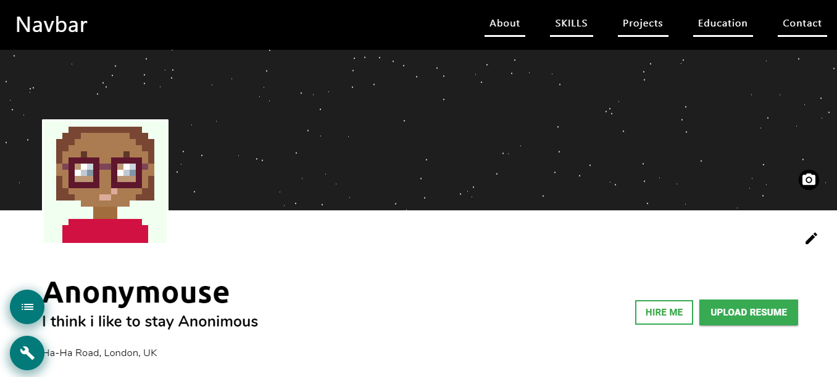

Proposed solution:
Users initially need to Authenticate themselves.
They can choose their portfolio template.
The template is loaded to them.
Users can then edit the template using click and select & drag and drops.
After they have edited the website they can save their website.
After saving the website they can deploy their website on our platform.
After deployment the users are provided a hyperlink to their deployed website
The Website can be accessed by anyone at anytime.

Slide 11
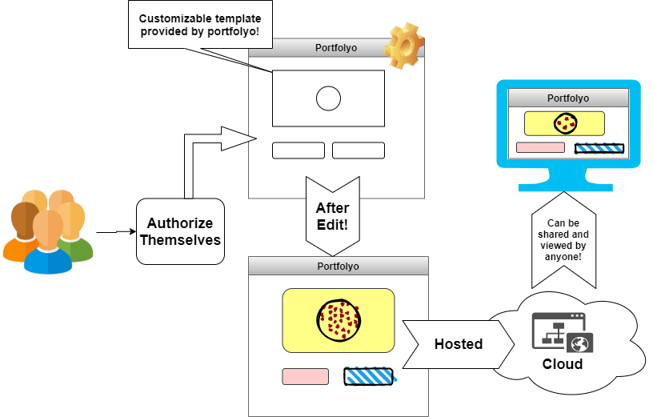
Flow Chart:

Slide 12
Software requirements:
FrontEnd Technologies:
BackEnd Technologies:
React
HTML
SCSS
JavaScript
Material-UI
Redux
Chakra-UI
NodeJs
ExpressJs
MongoDB
Redis
Docker
Nginx
RestAPI

Slide 13
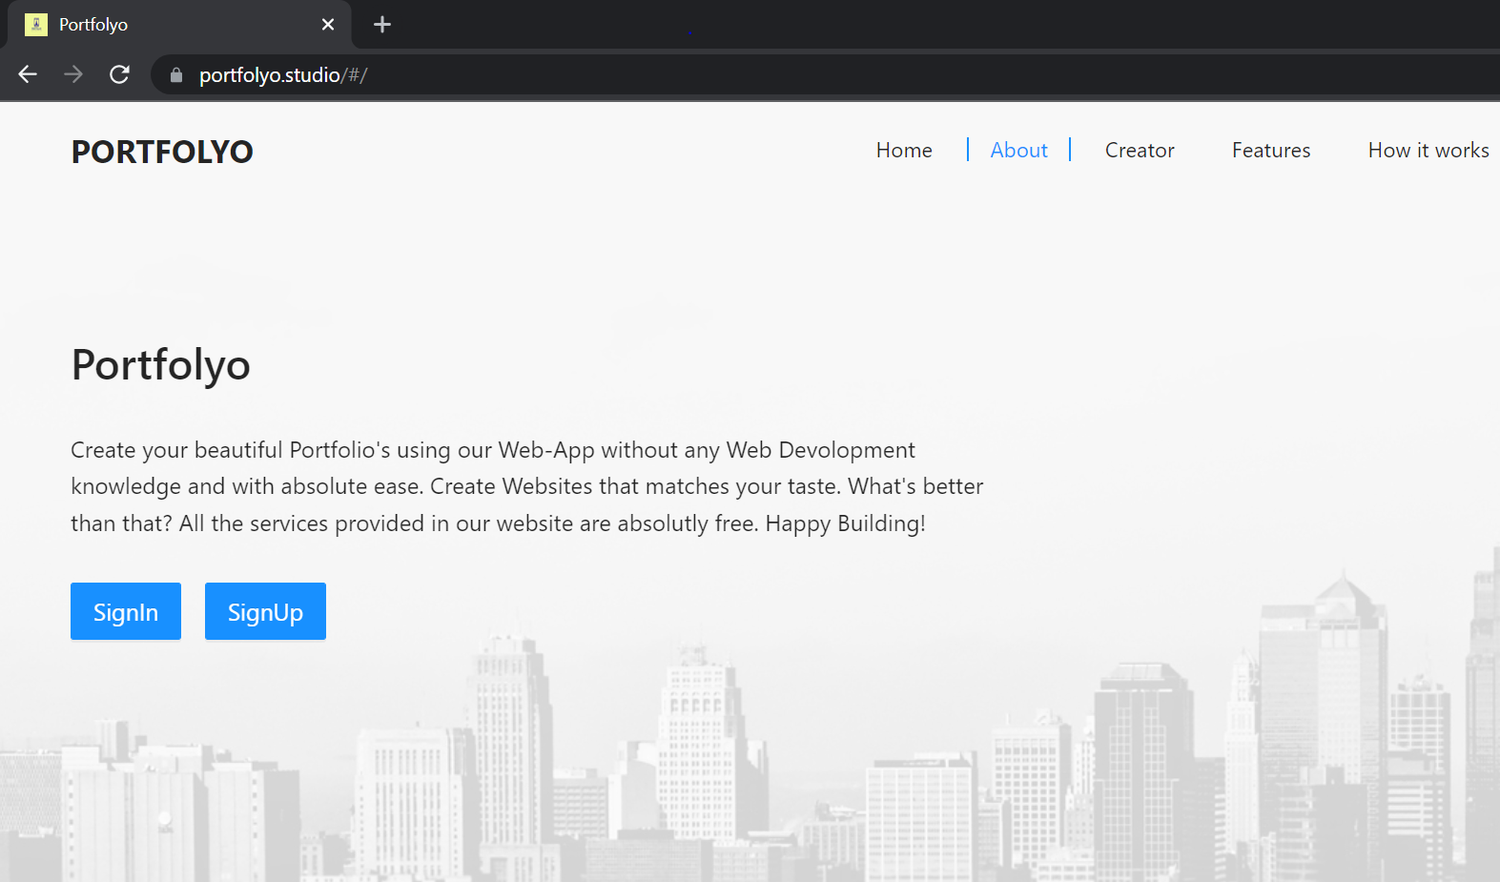
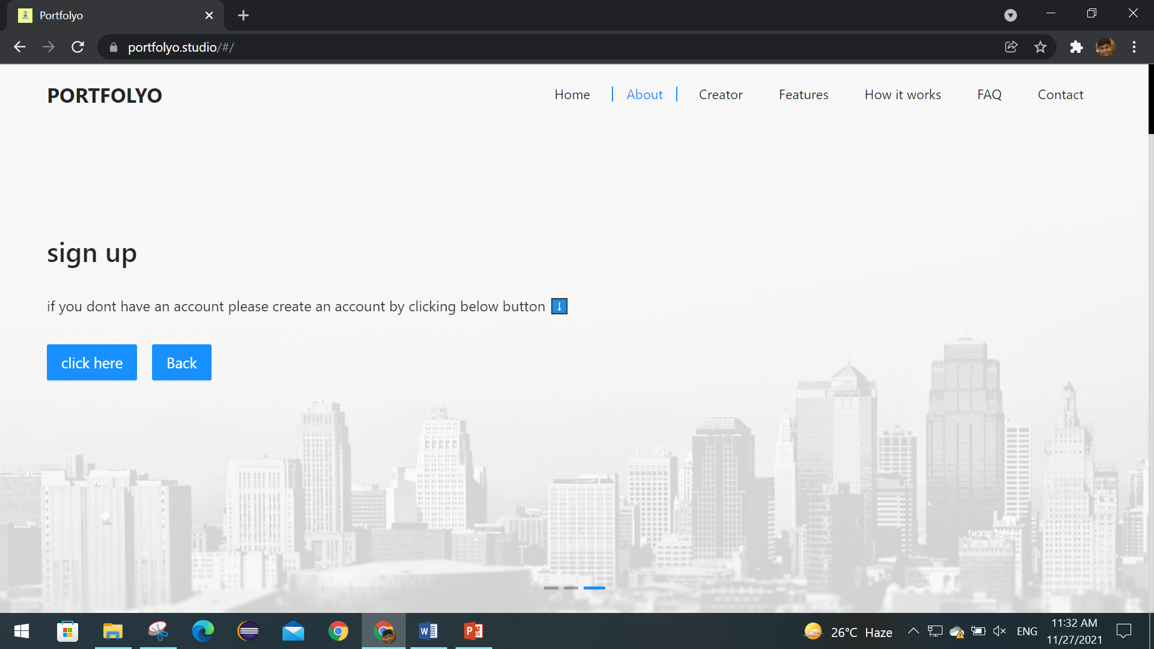
Steps to create an account :
Search for portfolyo.studio or click on the website link to access it.
To create an account click on signup.
To sign up click on click here.
Then , fill in your details to create an account.

Slide 14
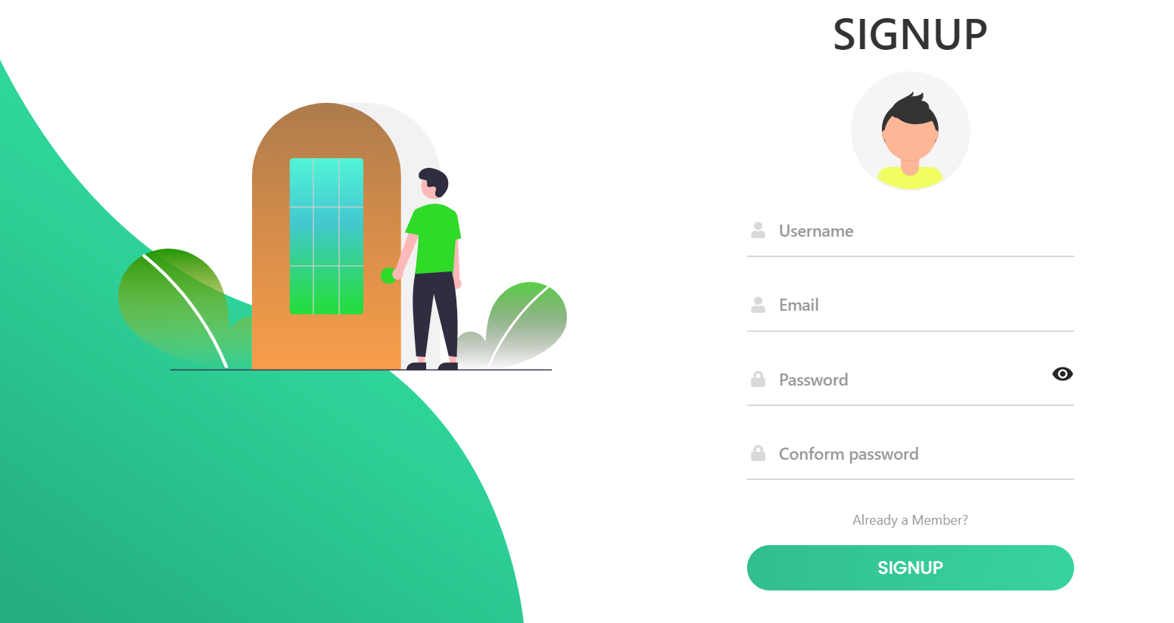
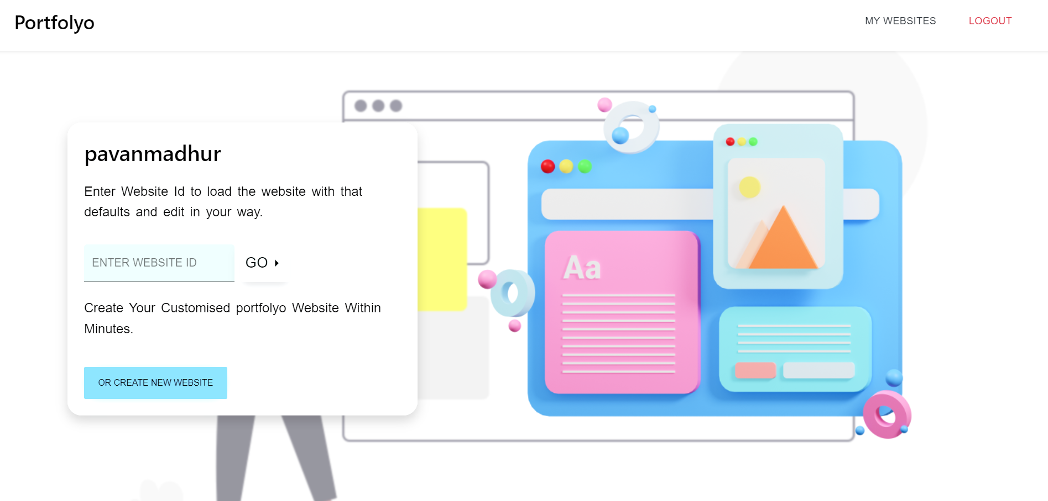
After creating an account sign in with the registered mail id and create your own website.
Click on create new website to create one.
Build your resume as per your needs and taste.

Slide 15
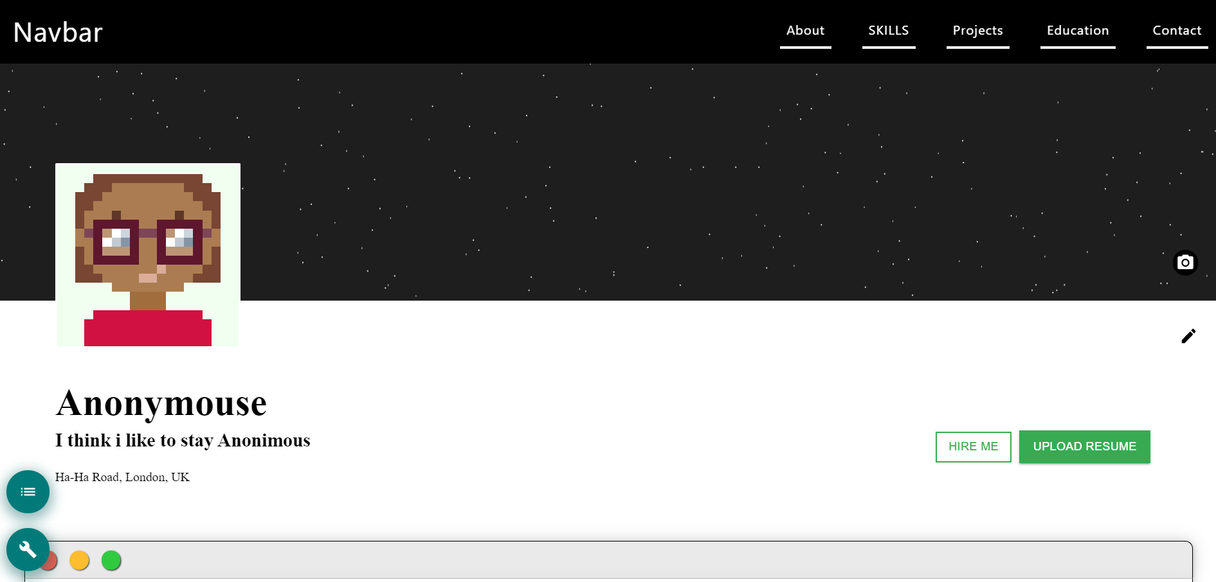
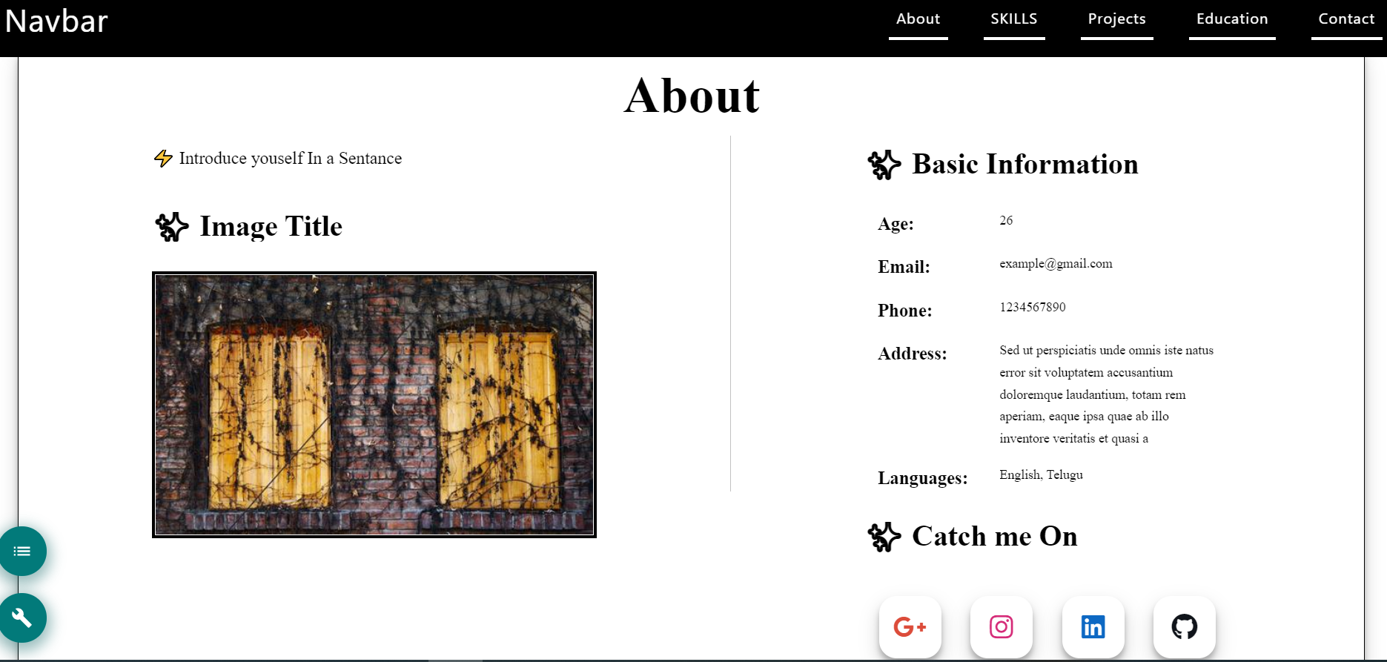

Slide 16
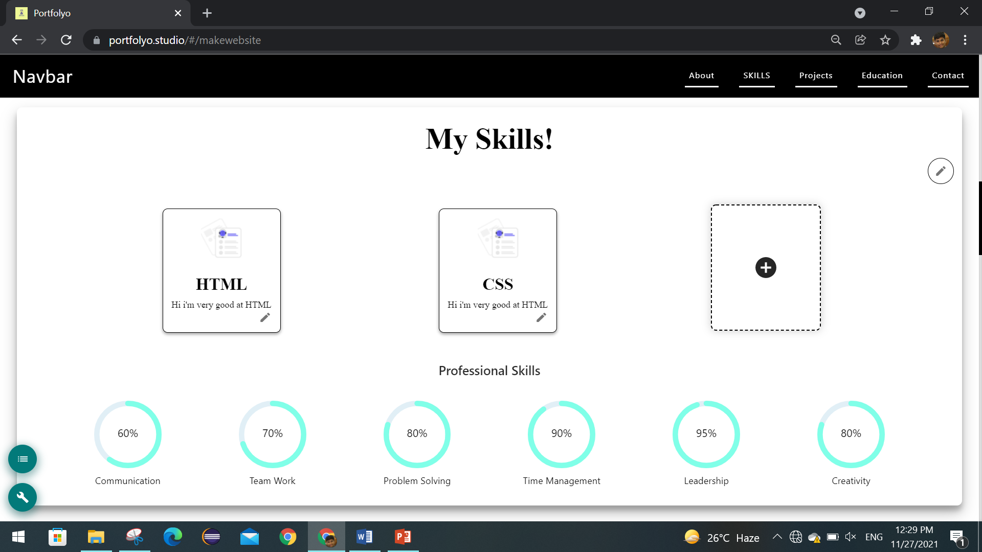

Slide 17
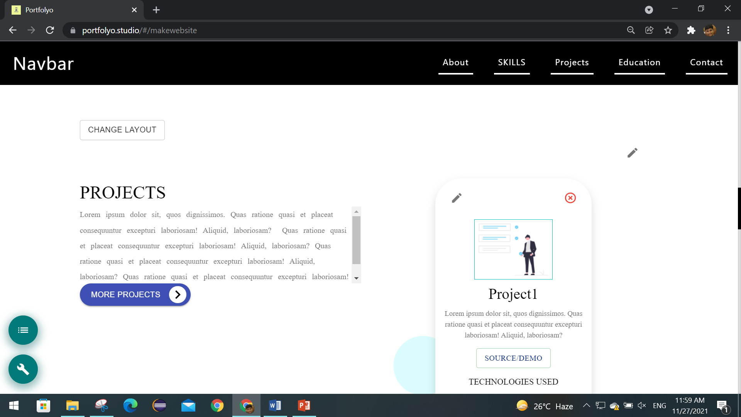

Slide 18
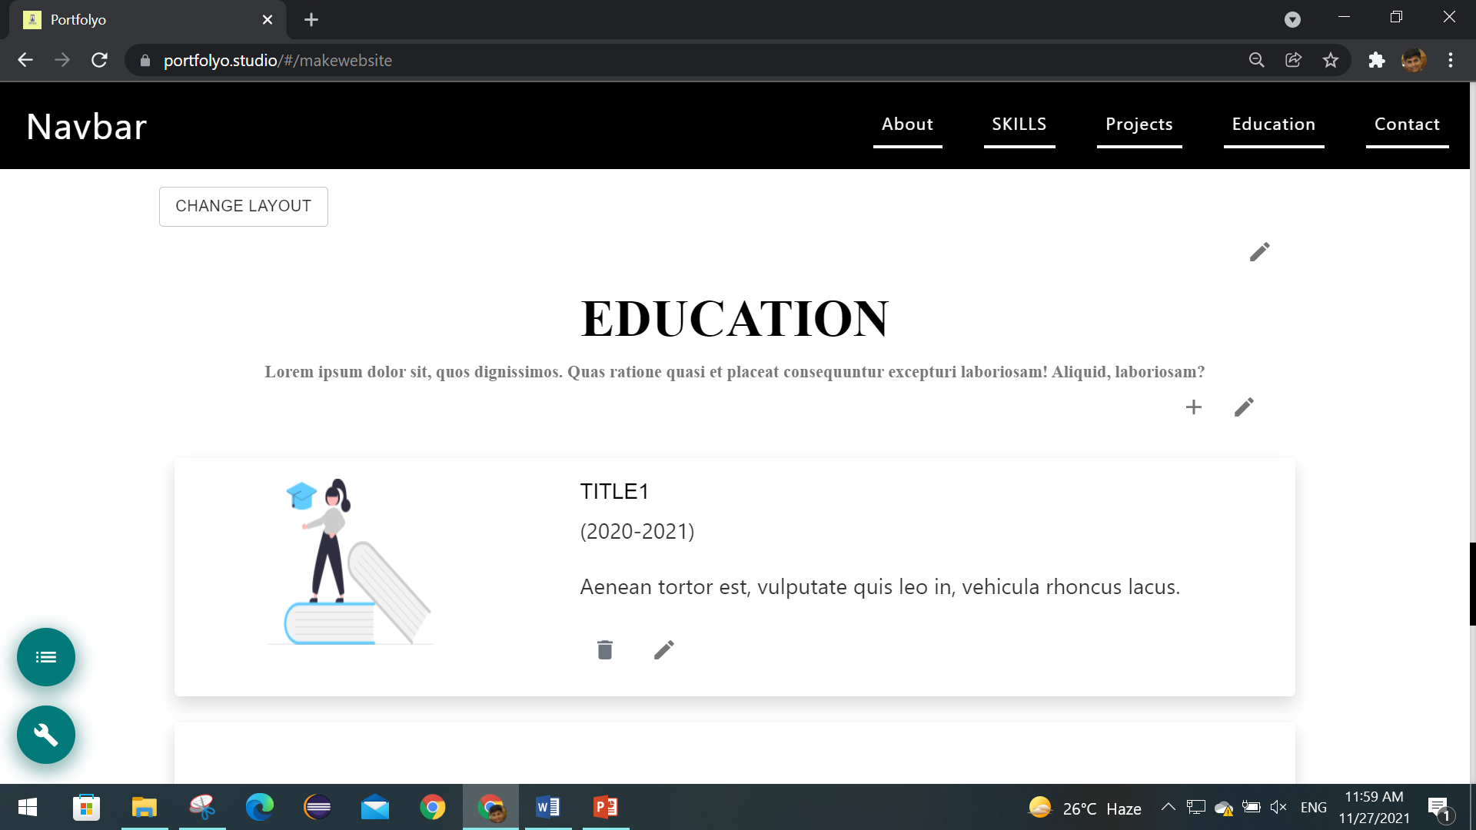

Slide 19
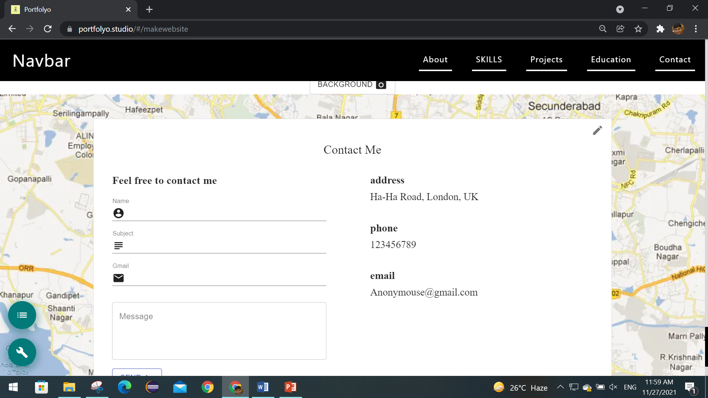

Slide 20
Conclusion :
Portfolyo can be a better choice if you do not have any knowledge on creating websites.
Accessing portfolio website is easier than you think.
Build your own website with portfolyo.
Why learning web development from scratch.? When you have portfolyo..!
Create Portfolio’s that matches your taste and character.

Slide 21
References:
https://www.creativebloq.com/features/8-common-portfolio-mistakes-and-how-to-fix-them
https://www.wix.com/
https://www.bluehost.com/cs/special/wordpress-builder/?utm_source=%28direct%29&utm_medium=affiliate&utm_campaign=affiliate-link_quicksprout_notype

Slide 22
Thank you!
portfolyobuilder@gmail.com
https://portfolyo.studio/#/

